Slide 1
Long: Vertiv (NYSE: VRT)
September 2024
Ty Gelman
University of Pennsylvania
tygelman@sas.upenn.edu

Slide 2
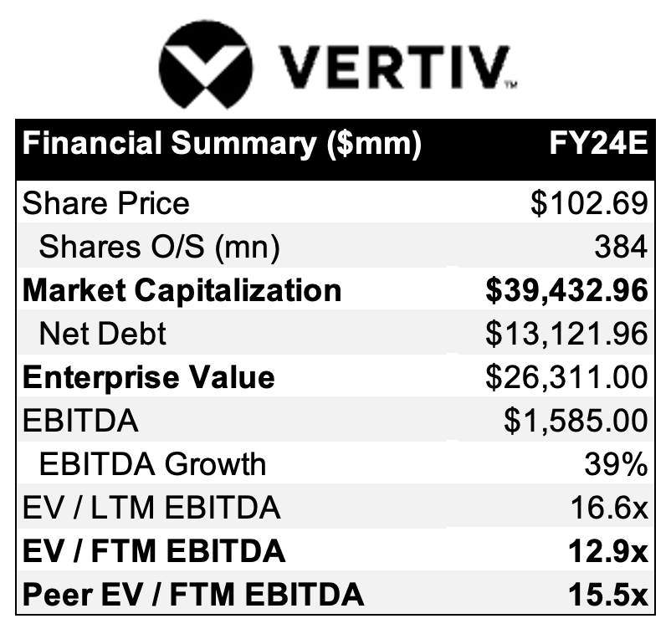
Investment Summary
Recommend loong position on Vertiv (‘VRT’, ‘the Company’); FY26E EPS target of $4.35, implying a 66.0% return.
Investment thesis:
Street underestimates robust growth in data center spending and hyperscaler capex
Leading supplier in differentiated EE/MI market with high barriers to entry
Reasonable valuation in light of impressive margin/FCF/balance sheet improvement
Massive revenue backlog to 3Q2025

Slide 3
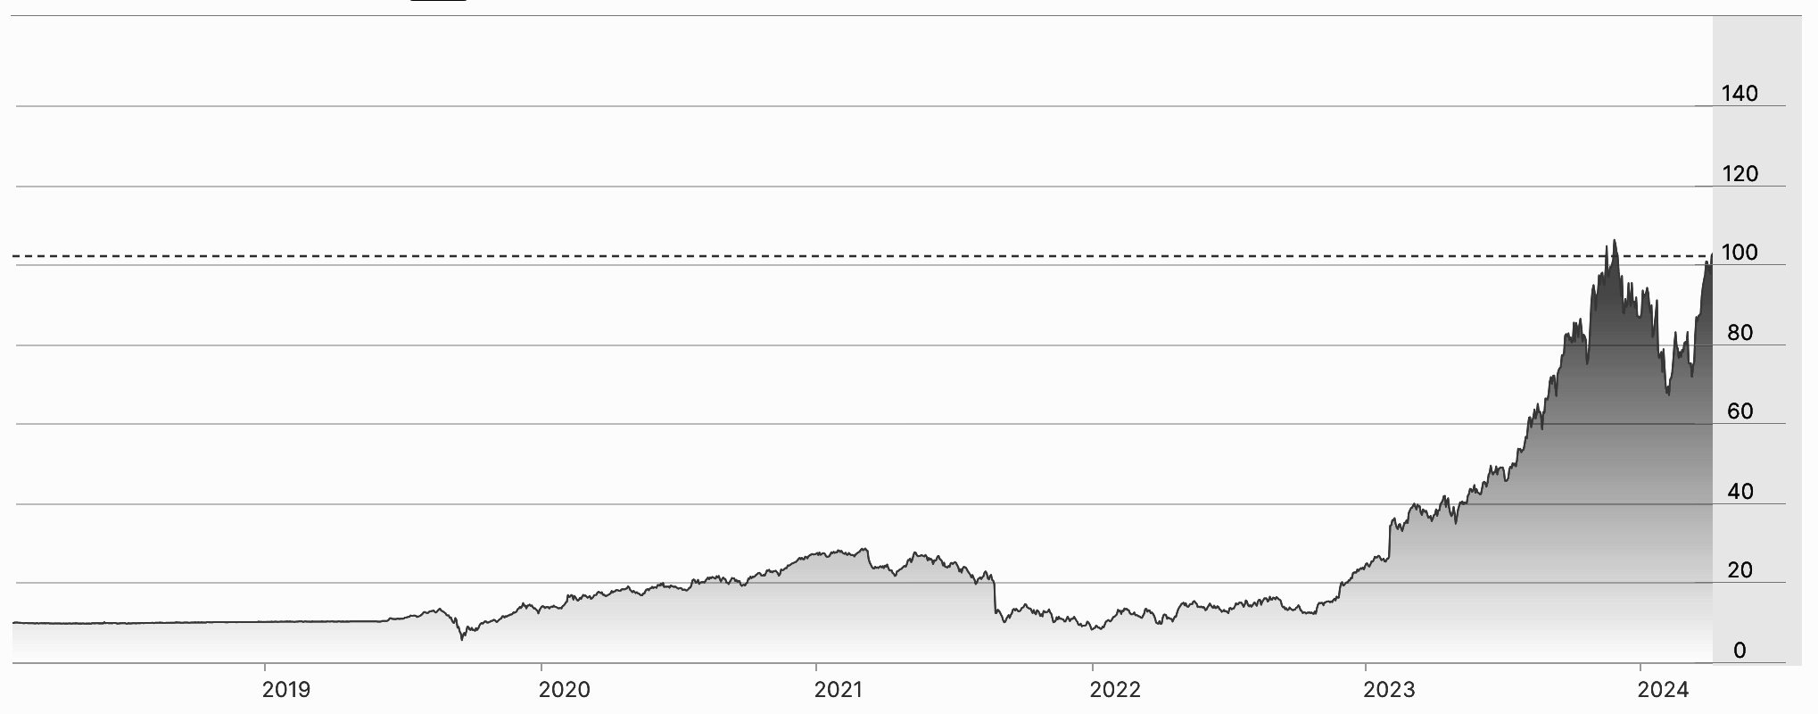
Opportunity Overview & Stock Performance
VRT provides electrical power equipment, thermal management, monitoring and management tools and other services. The Company services data centers, communication networks, commercial, and industrial environments worldwide.
VRT up 905% in last 5 years
compared to S&P 500 up 97.12%
The opportunity exists because:
4Q24 hyperscaler capex showing greater than expected growth driven by cloud and data storage investments
H2 2023 & H1 2024 mammoth AI spending backlog yet to be recognized until H2 2025
Massive EE/MI industry barriers to entry → VRT liquid/immersion cooling ahead of competitors
VRT is trading at a reasonable price in a defined set of marketplace peers with impressive books
3Q24 UPDATE: Share price up 28.36% since 2Q 2024 earnings reported 57% in organic growth orders and 63% operating profit growth.

Slide 4
A Note on Tangential Trends
Since OpenAI released ChatGPT November 30, 2022:
NVDA stock is up 632%
CRWD stock is up 132.3%
ORCL stock is up 103.5%
MSFT stock is up 63%
DLR stock is up 41%
S&P 500 index is up 40%
The impact of AI/LLM/ML research and development has formed a wave of tangential AI trends. AI workloads require data storage and security (CRWD, ORCL, MSFT) Data storage, security, and processing requires hardware and processing power (NVDA). Hardware requires massive housing space to operate (DLR). Hardware requires maintenance and infrastructure to support functions, such as cooling to prevent overheating (VRT). It is clear that these companies act as proxies, however some are less obvious than others.

Slide 5
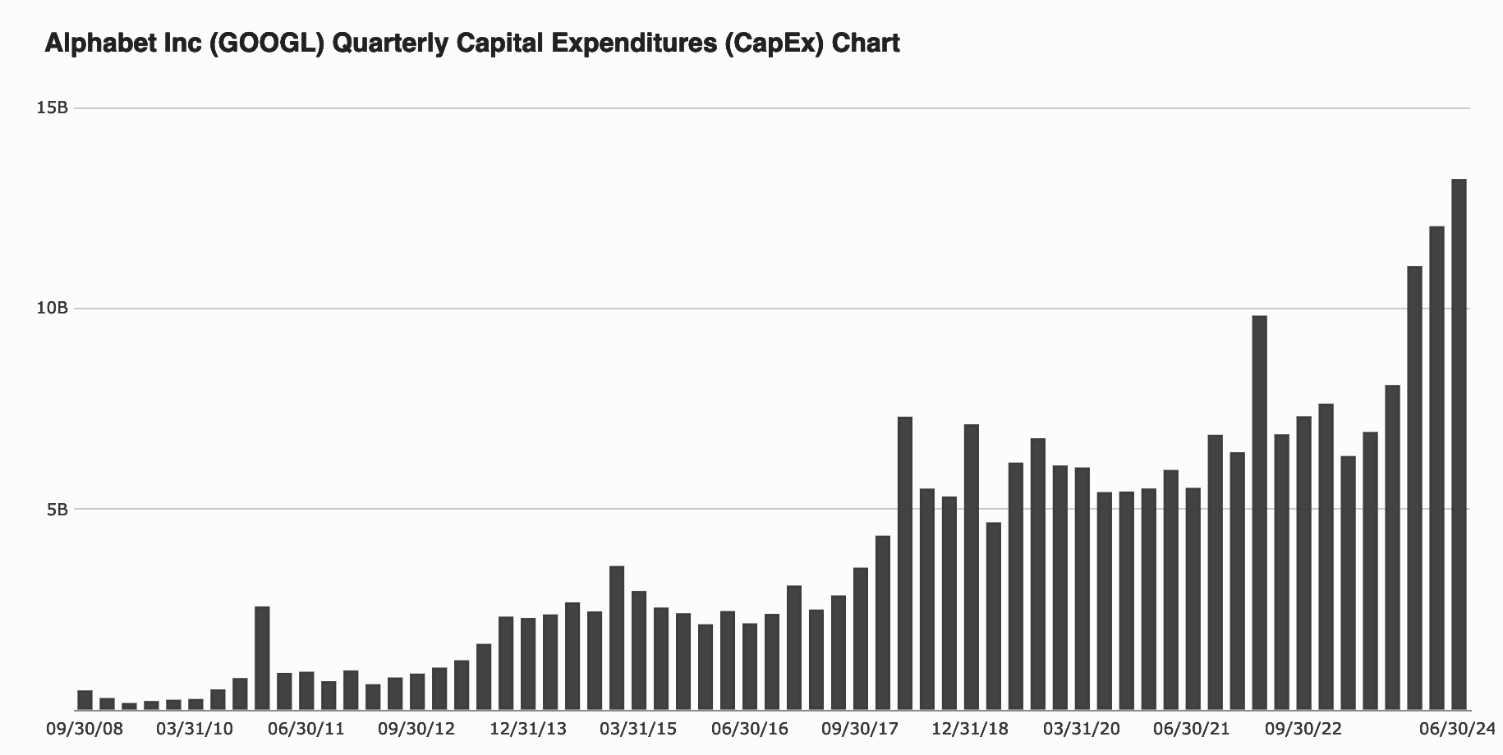
A Note on Data Centers & Hyperscalers
Types of Data Centers:
Edge/Micro: Small and located near people they serve. Low-latency communication as close to end users as possible.
Colocation: Multi-tenant, organizations can lease amount of space they need to host data.
Enterprise: Private facilities supporting a single organization.
Hyperscale: Like enterprise, owned and operated by the company they support, just on a much larger scale. Amazon (AWS), Google (GCP), & Microsoft (Azure) account for more than half of all hyperscale data centers.
Hyperscalers are large cloud service providers (storage, security, computing) showing a 45% YoY increase in CapEx driven by the need for data center capacity.

Slide 6
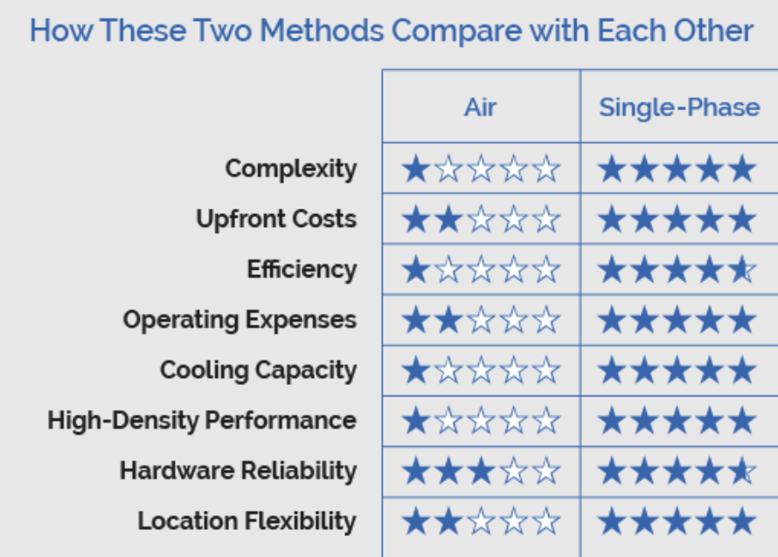
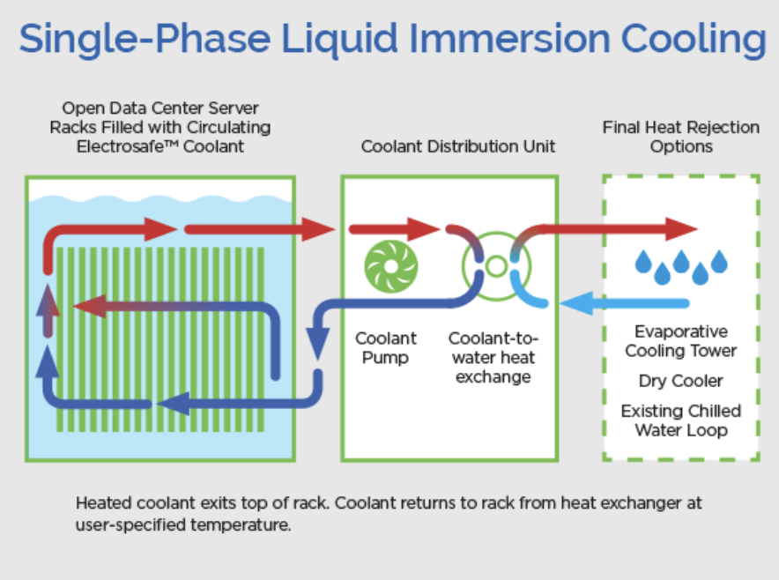
A Note on Cooling Systems
As enterprises, hyperscalers, and individuals demand more data handling capacity, data centers must become more dense. As a result, a shift from traditional air cooling to liquid/immersion cooling is essential, but will not be instant.
Traditional Air Cooling:
Dominant for low density work loads. Uses air to remove heat from servers and heavily relies on chillers and fans. Less effective for higher density data centers.
Liquid Cooling:
Cool liquid flows through tubes and passes over a plate placed directly on GPU. Efficiently draws heat away from processing components.
Single-Phase Immersion Cooling:
Servers are completely submerged in a non-conductive liquid. More efficient than air because liquids have higher thermal conductivity. Immersion cooling is also physically denser, so more efficient in that regard as well. Risks include leakage. Until IT
Source: https://www.grcooling.com/air-based-cooling-vs-liquid-based-cooling/

Slide 7
Thesis 1
Tailwinds: Data Center Growth & Hyperscaler CapEx

Slide 8
Thesis 1: Data Center Growth

Slide 9
Thesis 1: Hyperscaler CapEx Growth

Slide 10
Thesis 2
Differentiated Offerings & High Entry Barriers

Slide 11
Thesis 2: Differentiated Offerings
Competitive landscape
Early entry

Slide 12
Thesis 2: High Barriers to Entry

Slide 13
Thesis 3
Strong Financials @ Reasonable Valuation

Slide 14
Thesis 3: Financials
Earnings Growth
Historical EPS of 73.3%
EPS is expected to grow 46.3% this year, crushing the industry average of 6.3%
3Q 2024 earnings beat $0.59 expectation at $0.67. 2Q 2024 earnings beat $0.37 expectation at $0.43.
Cash Flow Growth
YoY cash flow growth is 88.4% compared to peers of -14%

Slide 15
Thesis 3: Financials

Slide 16
Thesis 3: Reasonable Industry Valuation

Slide 17
Thesis 3: Reasonable Industry Valuation

Slide 18
Thesis 4
Trade Opportunity: Revenue Backlog

Slide 19
Thesis 4: Revenue Backlog to 3Q 2025 Recognition

Slide 20
Thesis 4: Revenue Backlog to 3Q 2025 Recognition

Slide 21

www.vertiv.com

